Slide 1
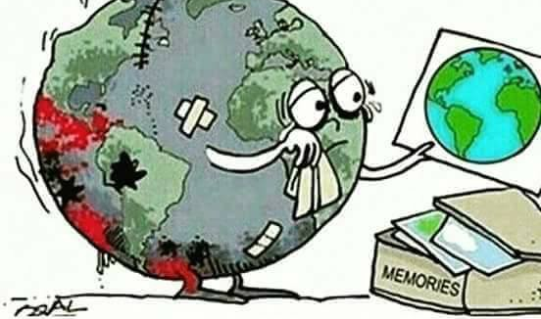
Planned Obsolescence & Sustainability
Thomas Karamanlis
Anatolia College

Slide 2
Project aim and objectives
AIM
Describe planned obsolescence and its environmental consequences and finally, create a more sustainable environment.
OBJECTIVES
Define planned obsolescence
Present the environmental, societal and economic consequences of planned obsolescence
Describe the 4 selected Sustainable Development Goals (SDGs)
Provide eco-friendly initiatives

Slide 3
Overview of Presentation
Define planned obsolescence
The environmental, societal and economic impact
Sustainability – The three pillars
What can WE do?
The 4 SDGs

Slide 4
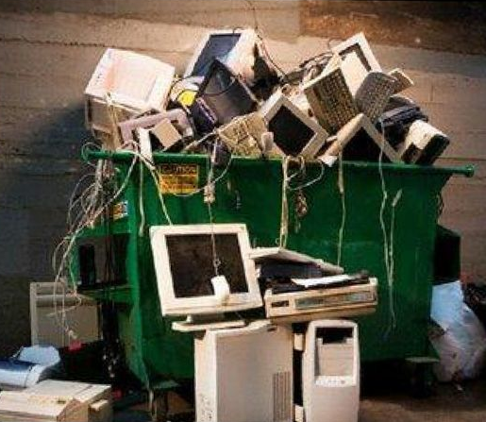
What is Planned Obsolescence?
The term “planned obsolescence” was first presented in a brochure during the Great Depression in America written by Bernard London in 1932, titled “Ending the Depression through Planned Obsolescence” (Kuppelwieser et al., 2019).
In 1954, Brooke Stevens described the term as "instilling in the buyer the desire to own something a little newer, a little better, a little sooner than is necessary“ (Satyro et al., 2018).
OR
“Planned obsolescence” is defined as the continuous product development which promotes shorter durables replacement and disposal cycles with troublesome environmental consequences (Guiltinan, 2009), effectively ending longevity.
Video:
https://www.youtube.com/watch?v=mtlPUmP6M1g

Slide 5
The symbol of Planned Obsolescence: The light bulb
Hours
Year

Slide 6
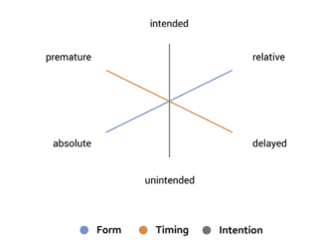
Planned Obsolescence and its 3 forms.
Form: PO results in absolute or relative obsolescence.
Time: PO leads to premature or delayed obsolescence of the product.
Intention: PO has intended and unintended results.
(Source: Longmuss and Poppe, 2017, pp. 218-219)

Slide 7
PO and Manufacturing
In 2016 the value added by the manufacturing sector in the EU accounted for 16.08% of its economy.
Examples:
Ireland 34.69%
Korea 29.34%
Czech Republic 27.08%
Hungary 23.90%
Slovenia, 23.34%
Germany 22.91%
UK 9.71%
US 12.27% and
Japan 20.55%
(OECD, 2017).
*The majority of jobs depend on manufacturing, for example, by transforming (through physical, chemical or mechanical processes) components, materials or substances, into new products (Satyro et al., 2018).

Slide 8
DEFENDERS
Planned obsolescence defenders argue that → new appliances are more energy-efficient and use less water than old ones while highlighting the need to replace product for income generation and ultimately keep production running (Hennies and Stamminger, 2016).
Planned obsolescence is not based on the intentional weakening of products – aiming at fast replacement – but by the conditions of creating, developing and producing. For instance;
rising complexity
increasing speed of innovation cycles
high cost pressures
competitiveness
These constraints leave little space to actors and companies of the development process
In this case obsolescence is systemic
(Longmuss and Poppe, 2017)
HOWEVER…

Slide 9
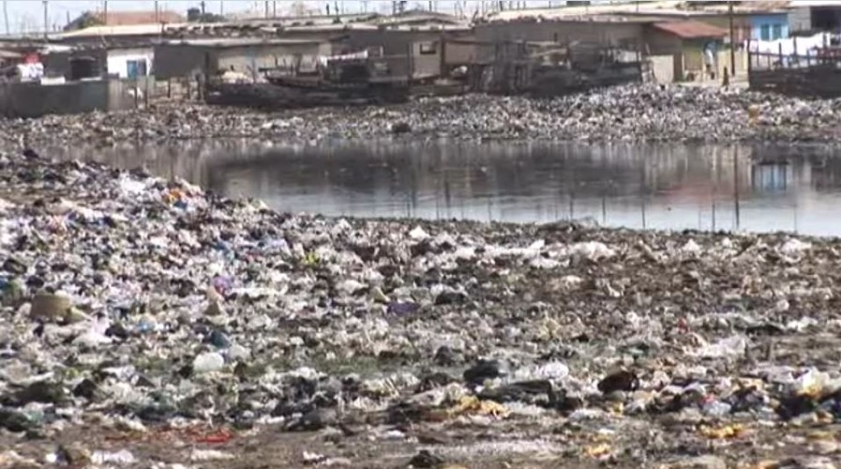
The Environment
Product replacement has created more transportation needs in order to reach the Western World, effectively polluting the environment due to transportation emissions
In turn, all products that have short lifespans, end up in countries such as Ghana, creating endless garbage graveyards and ultimately massive environmental, economic and societal implications

Slide 10
The Society
Societies have also been affected by planned obsolescence
For example, the phenomenon is highly connected to citizens’ health and their inability to remain in their communities resulting in “environmental immigrants”

Slide 11
The Economy
Exploitation of developing countries
Uncontrollable production in developing countries by the West
Resulting in uneven economic development (other than the environmental and societal costs affecting developing countries due to uncontrollable production)
(Kyrylych, 2013)

Slide 12
The Three pillars of Sustainability
(World Economic Forum, 2016)

Slide 13
Uncommon Interests

Slide 14
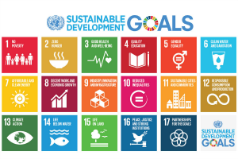
THE 17 SDGs
The UN’s 17 sustainable development goals (SDGs) are highly connected to planned obsolescence
The SDGs are global and have a timeframe for goal implementation by 2030 tailored for each country and the different levels of growth and national barriers that could be presented

Slide 15
Focus

Slide 16
PO CREATES WASTE IT CANNOT COPE WITH

Slide 17
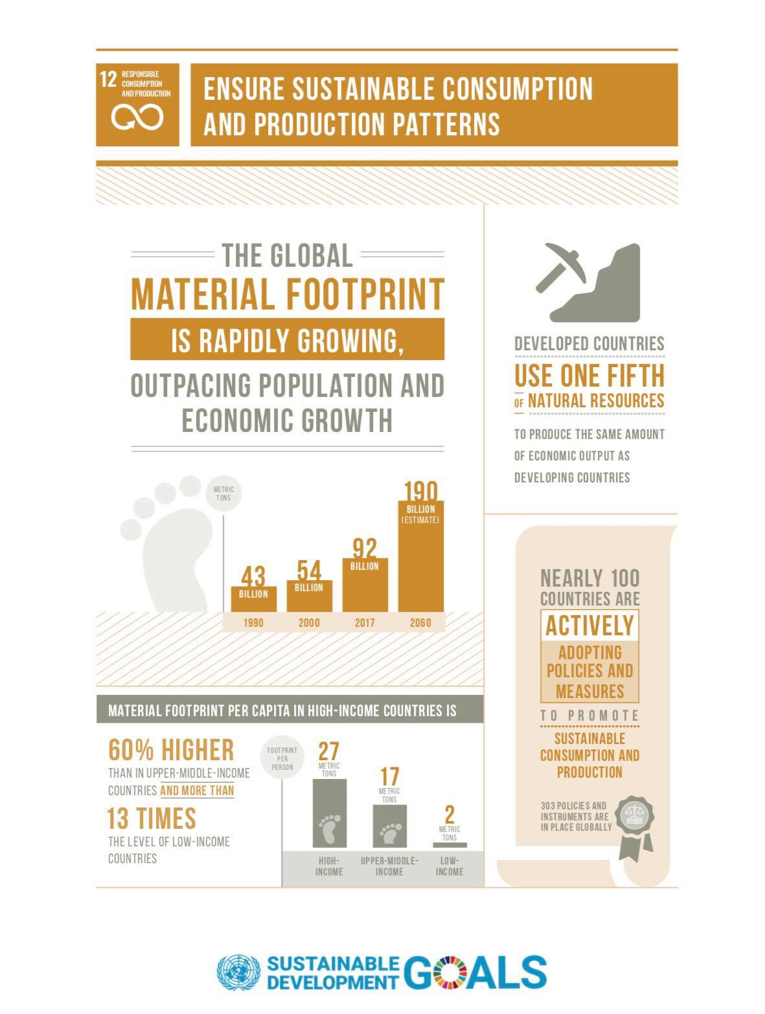
SDG 12 - Responsible consumption and production
PO is the opposite of goal 12
The transition to sustainable consumption and production of goods and services is necessary to reduce the negative impact on the climate, the environment and people’s health
Developing countries in particular are greatly affected by climate change and other environmental impacts, which lead to increased poverty and reduced prosperity
Goal 12 aims at ensuring sustainable consumption and production patterns
(United Nations, 2019)

Slide 18
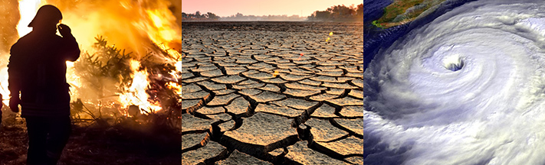
SDG 13 – Climate Change
Due to PO climate change is worsening (Hadhazy, 2016)
Greed, mankind and mass production have contributed to the global issue of climate change
All countries have been drastically affected by global warming
SDG 13 aims at addressing the needs of countries to adapt and mitigate climate change effects
(UNEP, 2019)

Slide 19
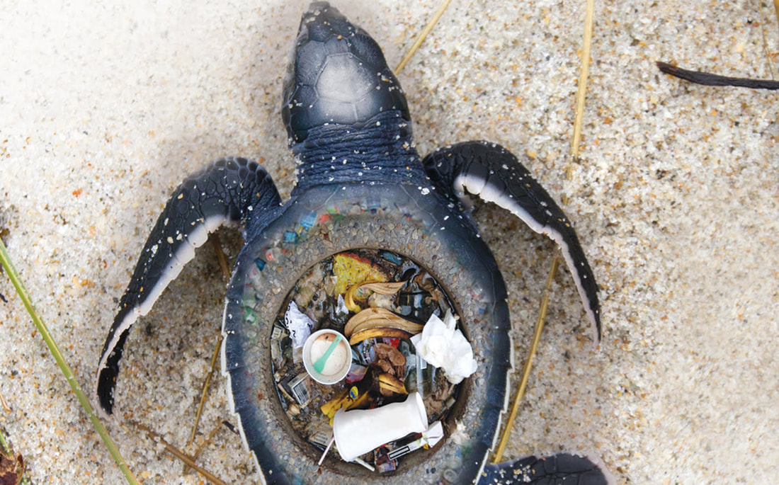
SDG 14 – Life below water
Mass production and by extension planned obsolescence has contaminated seas and has affected marine lives
SDG 14 aims to sustainably use oceans and seas
Goals by 2020:
pollution of all kinds → reduced
coastal ecosystems → protected
ocean acidification → minimized
overfishing → regulated
10% of coastal marine areas → conserved
Implement international law as presented in the United Nations Convention on the Law of the Sea in order to enhance sustainable use of the ocean
(Vladimirova and Le Blanc, 2016)

Slide 20
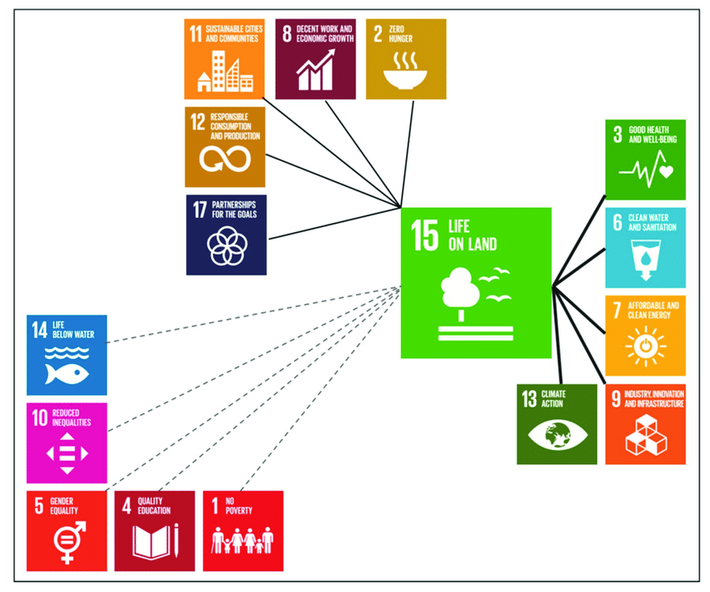
SDG 15 - Life on land
2.6 billion people are dependent directly on agriculture, but 52% of the land used for agriculture is severely affected by soil degradation
Arable land loss is estimated at 30 to 35 times the historical rate
Due to drought and desertification, 12 million hectares are lost each year (23 hectares per minute). Within one year, 20 million tons of grain could have been grown
74% of people are directly affected by land degradation globally
Goal 15 aims at providing environmental services necessary to protect the land and also aims at mitigating climate change
(United Nations, 2018)
*It could be described as the most important SDG due to its direct connection to all SDGs.

Slide 21
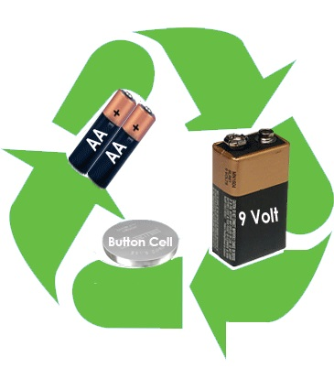
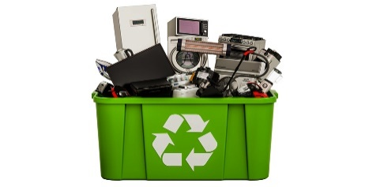
SUSTAINABLE & REUSABLE PRODUCTS & RECYCLING

Slide 22
References
European Parliament (2011). Προγραμματισμένη αχρήστευση. [Planned Obsolescence]. Available at: http://www.europarl.europa.eu/sides/getDoc.do?pubRef=-//EP//TEXT+WQ+E-2011-001284+0+DOC+XML+V0//EL [9 Nov. 2019].
Guiltinan, J., 2009. Creative destruction and destructive creations: Environmental ethics and planned obsolescence. Journal of Business Ethics, 89 (1), pp. 19–28.
Hadhazy, A. (2016). Here’s the truth about the ‘planned obsolescence’ of tech. BBC. Available at: https://www.bbc.com/future/article/20160612-heres-the-truth-about-the-planned-obsolescence-of-tech [Accessed 10 Nov. 2019].
Hennies, L. and Stamminger, R. (2016). An empirical survey on the obsolescence of appliances in German households. Resources, Conservation and Recycling, 112, pp.73-82.
Kuppelwieser, V., Klaus, P., Manthiou, A. and Boujena, O. (2019). Consumer responses to planned obsolescence. Journal of Retailing and Consumer Services, 47, pp.157-165.
Kyrylych, K. (2013). Problem of Uneven Economic Development of the World Economy: Essence and Causes. Intellectual Economics, 7(3), pp.344-354.
Longmuss, J. and Poppe, E. (2017). Planned Obsolescence: Who are those planners? Conference Paper. Available at: https://www.researchgate.net/publication/321028374_Planned_obsolescence_who_are_those_planners [Accessed 8 Nov. 2019] pp. 217-221.
Redline (2019). Προγραμματισμένη αχρήστευση προϊόντων: θεωρία συνωμοσίας ή πραγματικότητα; [Product Planned Obsolescence; A conspiracy theory or the truth?]. Available at: https://redlineagrinio.gr/greece/opinion/72060-programmatismeni-axristeusi-proionton-theoria-synomosias-pragmatikotita [Accessed 9 Nov. 2019].
Satyro, W., Sacomano, J., Contador, J. and Telles, R. (2018). Planned obsolescence or planned resource depletion? A sustainable approach. Journal of Cleaner Production, 195, pp.744-752.
UN (2018). HLPF Review of SDGs implementation: SDG 15 – Protect, restore and promote us of terrestrial ecosystems, sustainably manage forests, combat desertification, and halt and reverse land degradation and halt biodiversity loss. Available at: https://sustainabledevelopment.un.org/content/documents/196552018backgroundnotesSDG15.pdf [Accessed 9 Nov. 2019].
UN (2019). Goal 12: Ensure sustainable consumption and production patterns . Available at: https://www.un.org/sustainabledevelopment/sustainable-consumption-production/?fbclid=IwAR0wXUcrCNj654kS32WJ6WG9-AQ9Tgt2N4gzHlo7KFuH_tgFD5PGbT8asUw [Accessed 10 Nov. 2019].
UNEP (2019). Goal 13: Climate Action. Available at: https://www.undp.org/content/undp/en/home/sustainable-development-goals/goal-13-climate-action.html#:~:targetText=The%20goal%20aims%20to%20mobilize,also%20to%20the%20other%20SDGs. [Accessed 9 Nov. 2019].
Vladimirova, K. and Le Blanc, D. (2016). Exploring Links Between Education and Sustainable Development Goals Through the Lens of UN Flagship Reports. Sustainable Development, 24(4), pp.254-271.
World Economic Forum (2016). These are the world’s most sustainable cities. Available at: https://www.weforum.org/agenda/2016/09/these-are-the-world-s-most-sustainable-cities/ [Accessed 9 Nov 2019].

Slide 23
Thank You

